Slide 1


Can Machine Learning Predict the Sale Price of a House?

Slide 2
Got a problem? Try a 12 Step!
How Do I Solve a Machine Learning Problem?
Choose my problem
Choose my data
Clean my data
Analyze my data
Choose my model
Prime my model
Fit/Train my model
Test my model
Evaluate my model
Compete my model?
If no, continue, else go to #5
Apply my problem
Solve my problem

Slide 3
1. Choose my problem
Been there, done that.
But what to call the solution to the problem?
Real
Estate
Market
Price
ESTimator
Aka “REMPESTimator” !

Slide 4
2. Choose my data

Slide 5


Slide 6
2. Choose my data
Preferred data extraction method: scraping during active account session
But this was time prohibitive
Solution: download PDF file(s)
Very significant time savings
20 minutes vs 10 hours (est.)

Slide 7
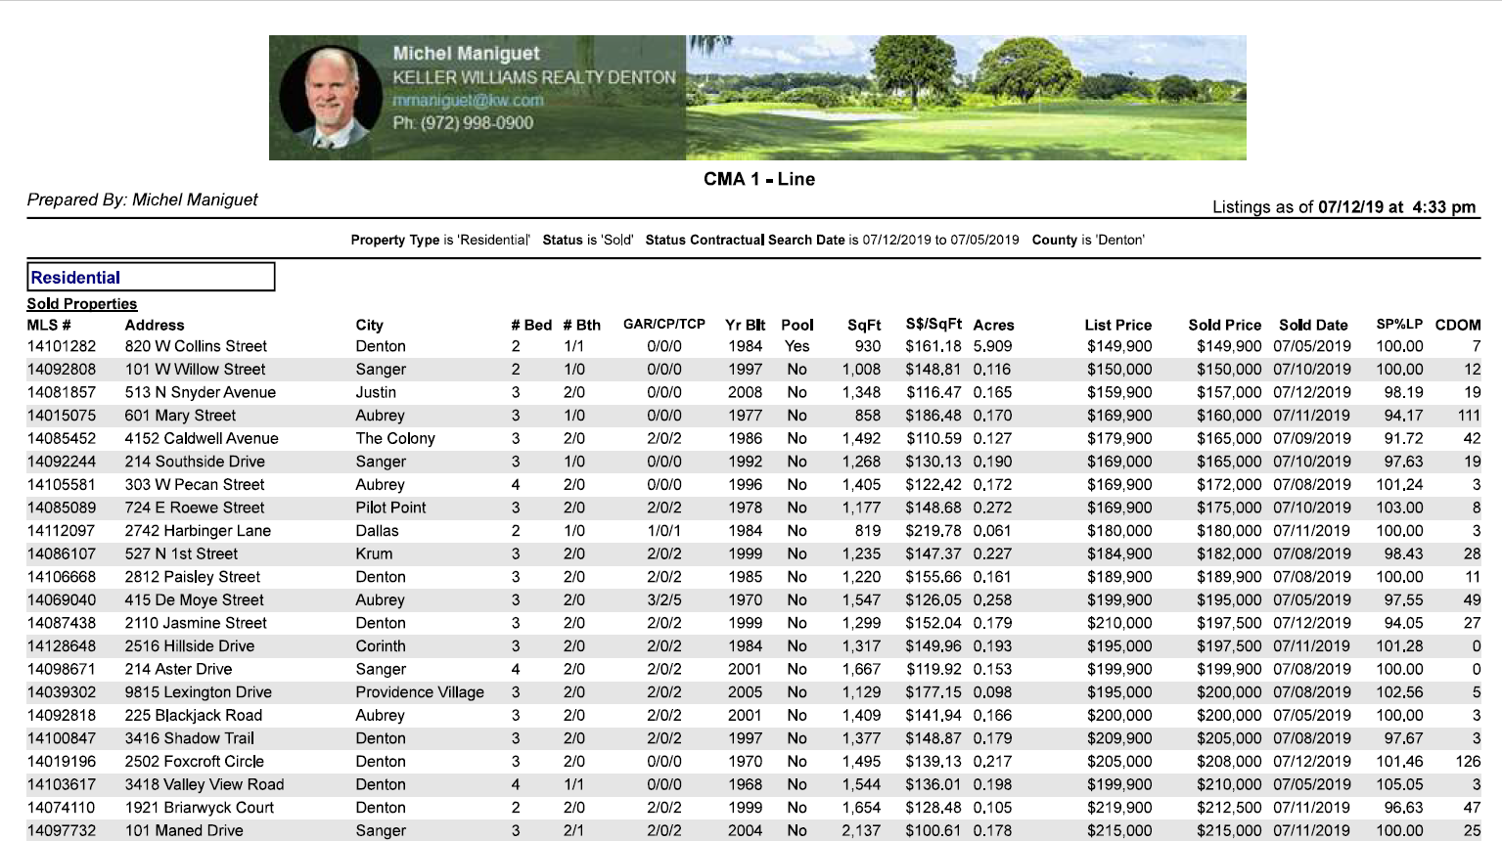

Slide 8
3. Clean my data
Jupyter Notebook
Tabula
import tabula
.
.
.
pd = tabula.read_pdf(“...pdf”)
Pandas
Python
(it was kind of ugly)

Slide 9
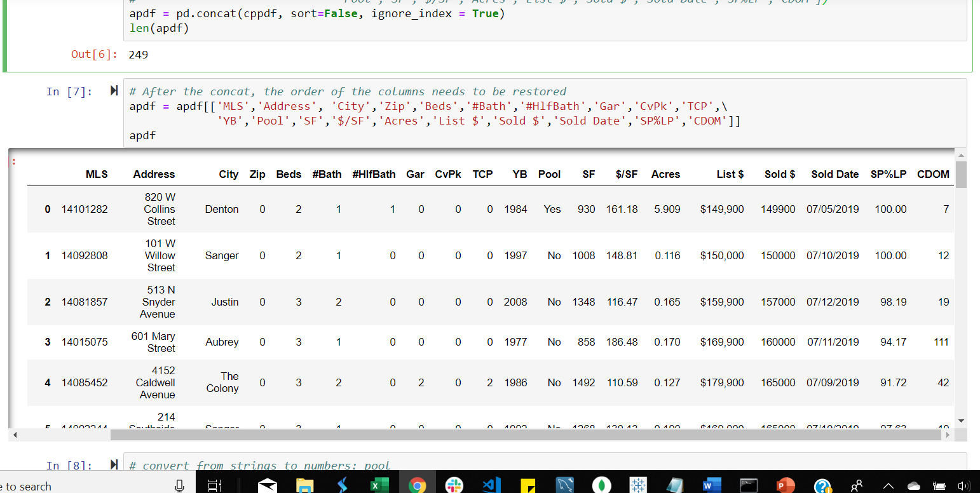
Cleaned Data in Pandas DataFrame

Slide 10
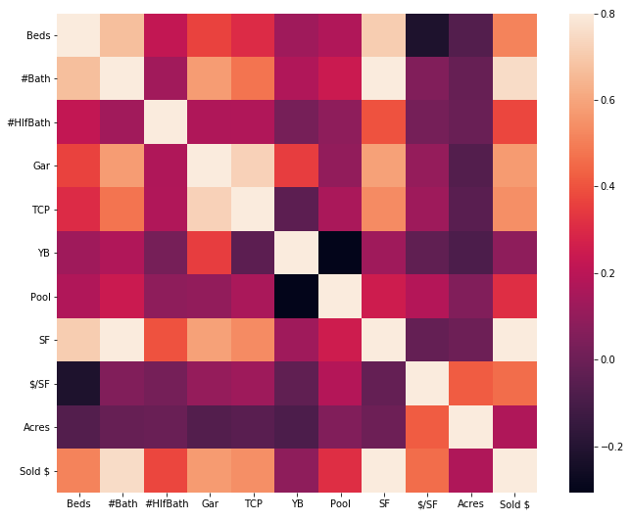
4. Analyze my data
Some plots…

Slide 11
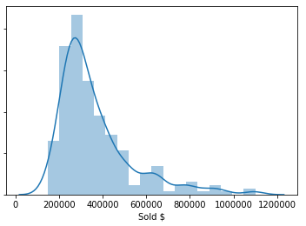
4. Analyze my data
Overall Distribution – of What???
(Sale Price vs Number of Homes)

Slide 12
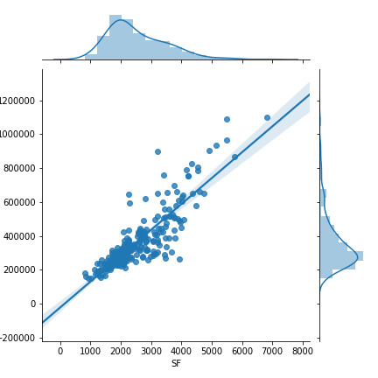
4. Analyze my data
Some plots…

Slide 13
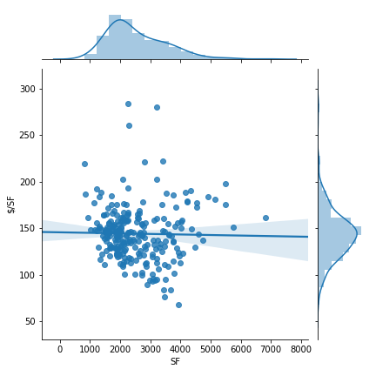
4. Analyze my data
Some plots…
Note the slightly inverse relationship between home square feet and price per square foot

Slide 14
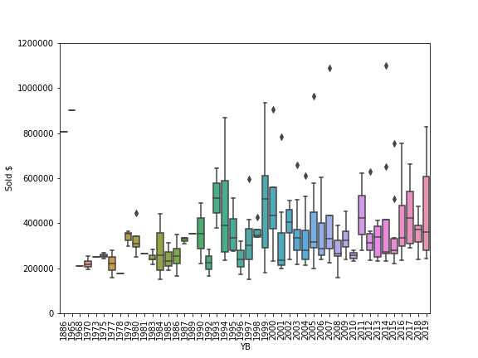
4. Analyze my data
All these YB were sold within 30 days
Some plots…

Slide 15
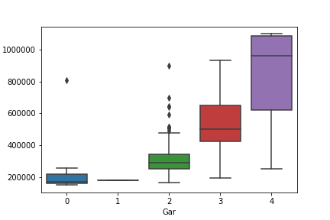
4. Analyze my data
Hint: It’s not what you think
(correlation != causation: proof later)

Slide 16
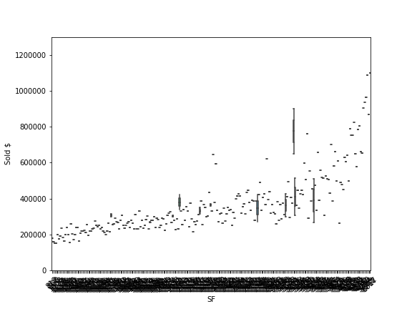
4. Analyze my data
Square Feet vs Sales Price
Some plots…

Slide 17
5. Select my model
Plenty of options
Problem category is key
Explore and compare options within the proper category

Slide 18

5. Choose your Model

Slide 19
5. Select my model
Final Models selection
Model 1: Multivariate Linear Regression
Model 2: Random Forest Regressor
Model 3: Gradient Boosting Regressor

Slide 20
6. Prime my model
“Huh ? Prime ?”
Yes, your engine needs some gas
Gas = fuel = data
So I went from this...

Slide 22
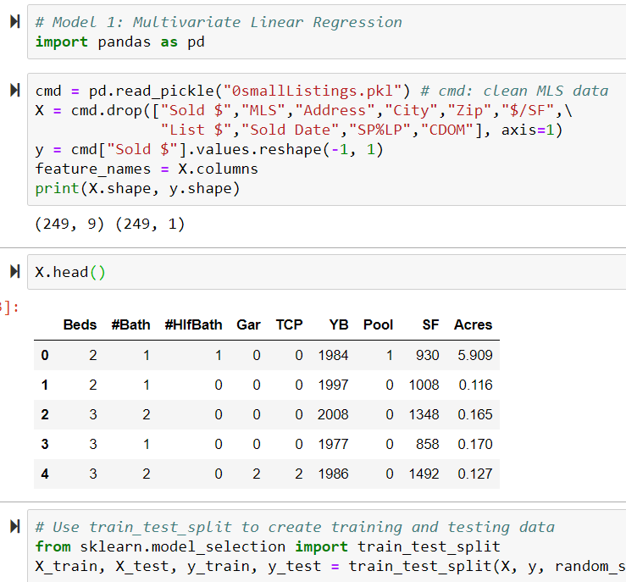
6. Prime my model
To this.
Note:
This shows MLR, but at this point they are all the same.

Slide 23
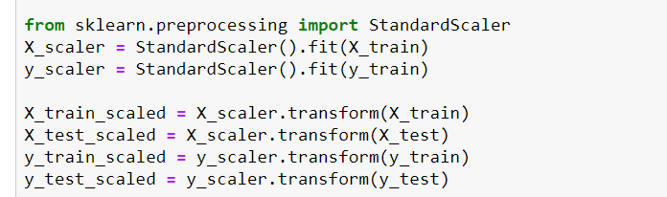
6. Prime my model
Additional prime step for MLR using Standard Scaler

Slide 24
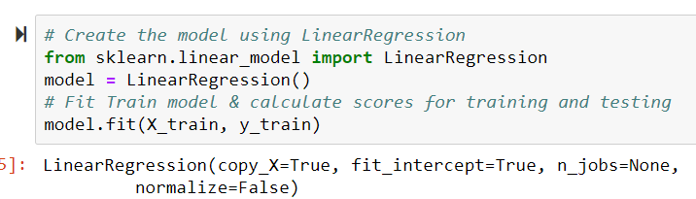
7.Fit/Train my model
Multivariable Linear Regression (MLR)

Slide 25
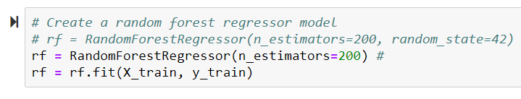
7.Fit/Train my model
Random Forest

Slide 26
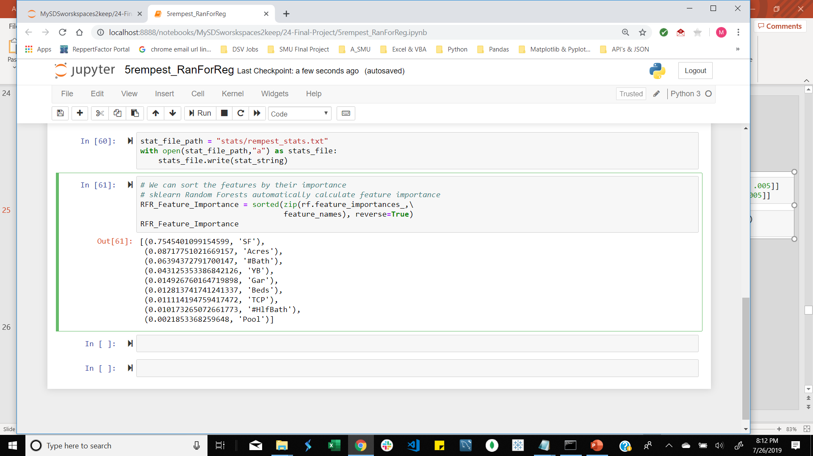
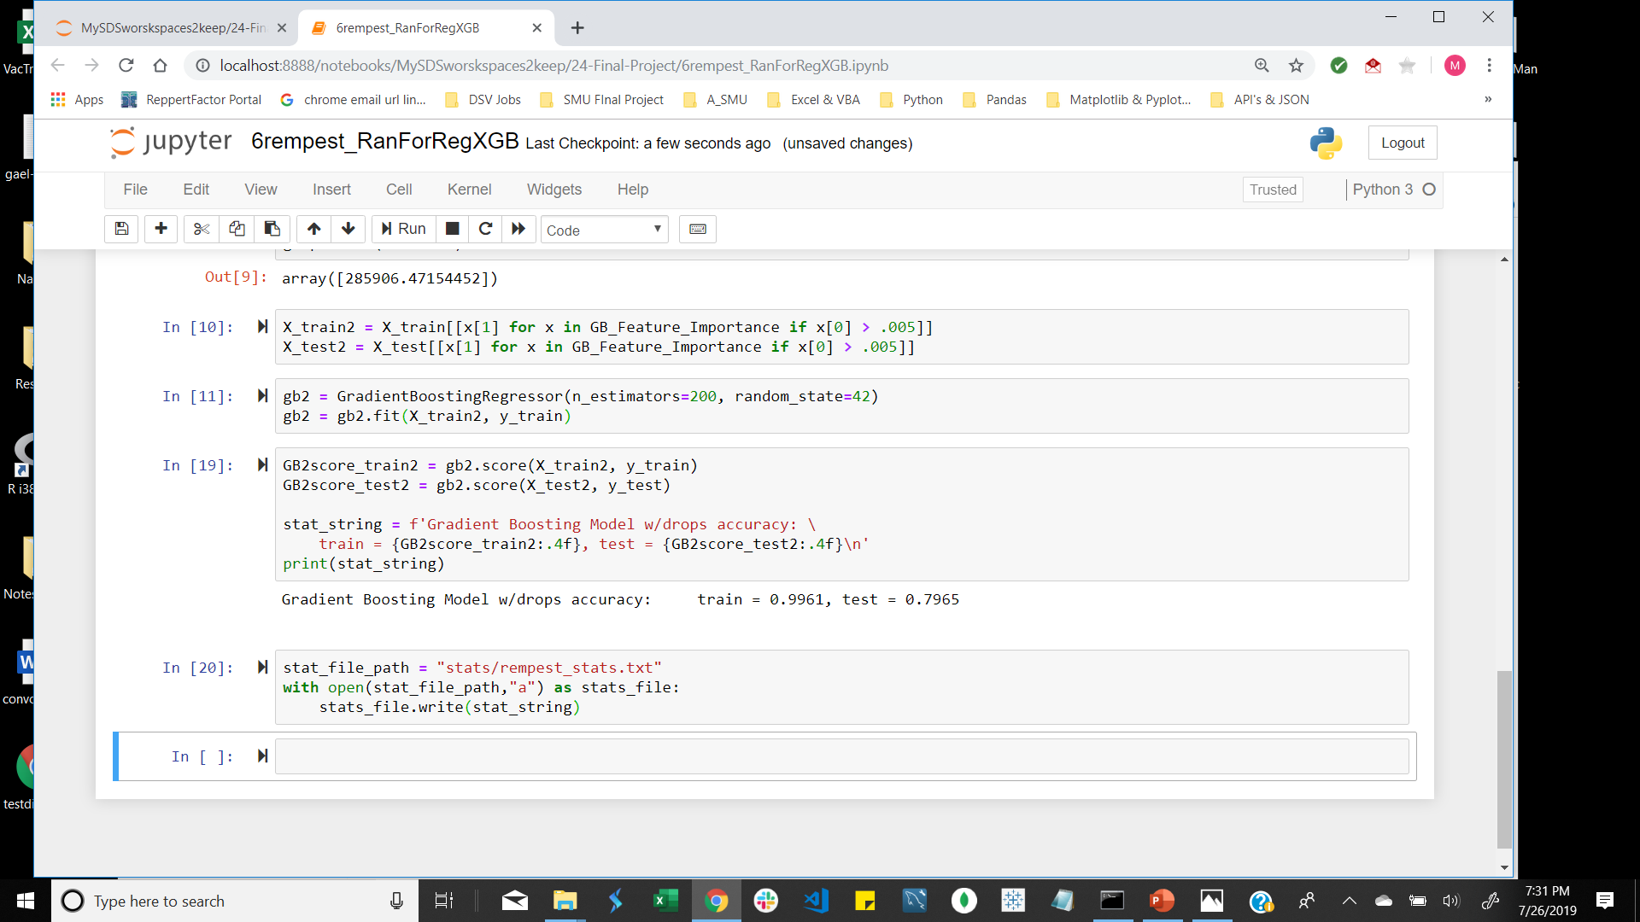
7.Fit/Train my model
Gradient Boost Regressor
Why
Drop?

Slide 27
7.Fit/Train my model
MLR
(regular and scaled)

Slide 28
8. Test my model
Example: Gradient Boost
(full test results comparison to follow)

Slide 29
9.Evaluate my model
Does the model meet requirements?
Is there a requirement?

Slide 30
10. Compete my model? If no, continue; else go to #5
Compete your Model?
If no, continue, else go to #5
Or “What’s the best we can do?”
Model Type Train Test
MLR 0.8363 0.7216
MLR Scaled 0.8363 0.7216
Random Forest 0.9773 0.8499
Gradient Boosting 0.9960 0.8137
Gradient Boosting w/drop 0.9961 0.7965

Slide 31
11. Apply my problem
Let’s solve it. Try fresh data.

Slide 33
12. Solve my problem
Now for an answer to that problem…
REMPESTimator to the rescue !
(From Bash or Vscode shell)

Slide 34
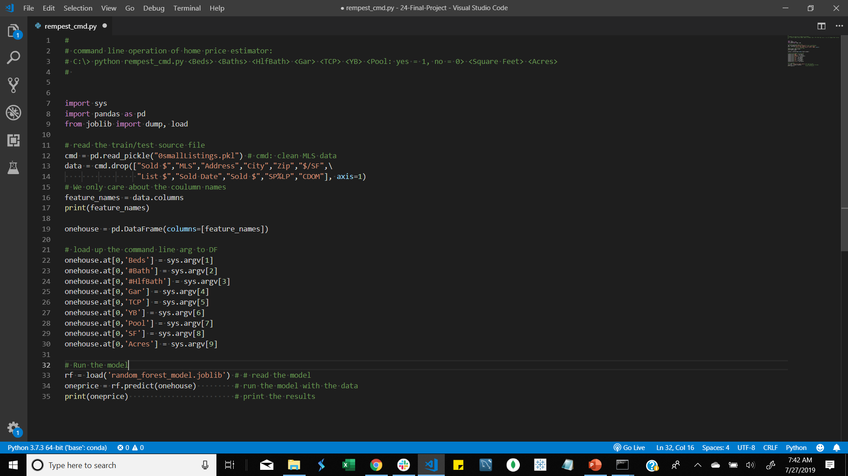

Slide 35
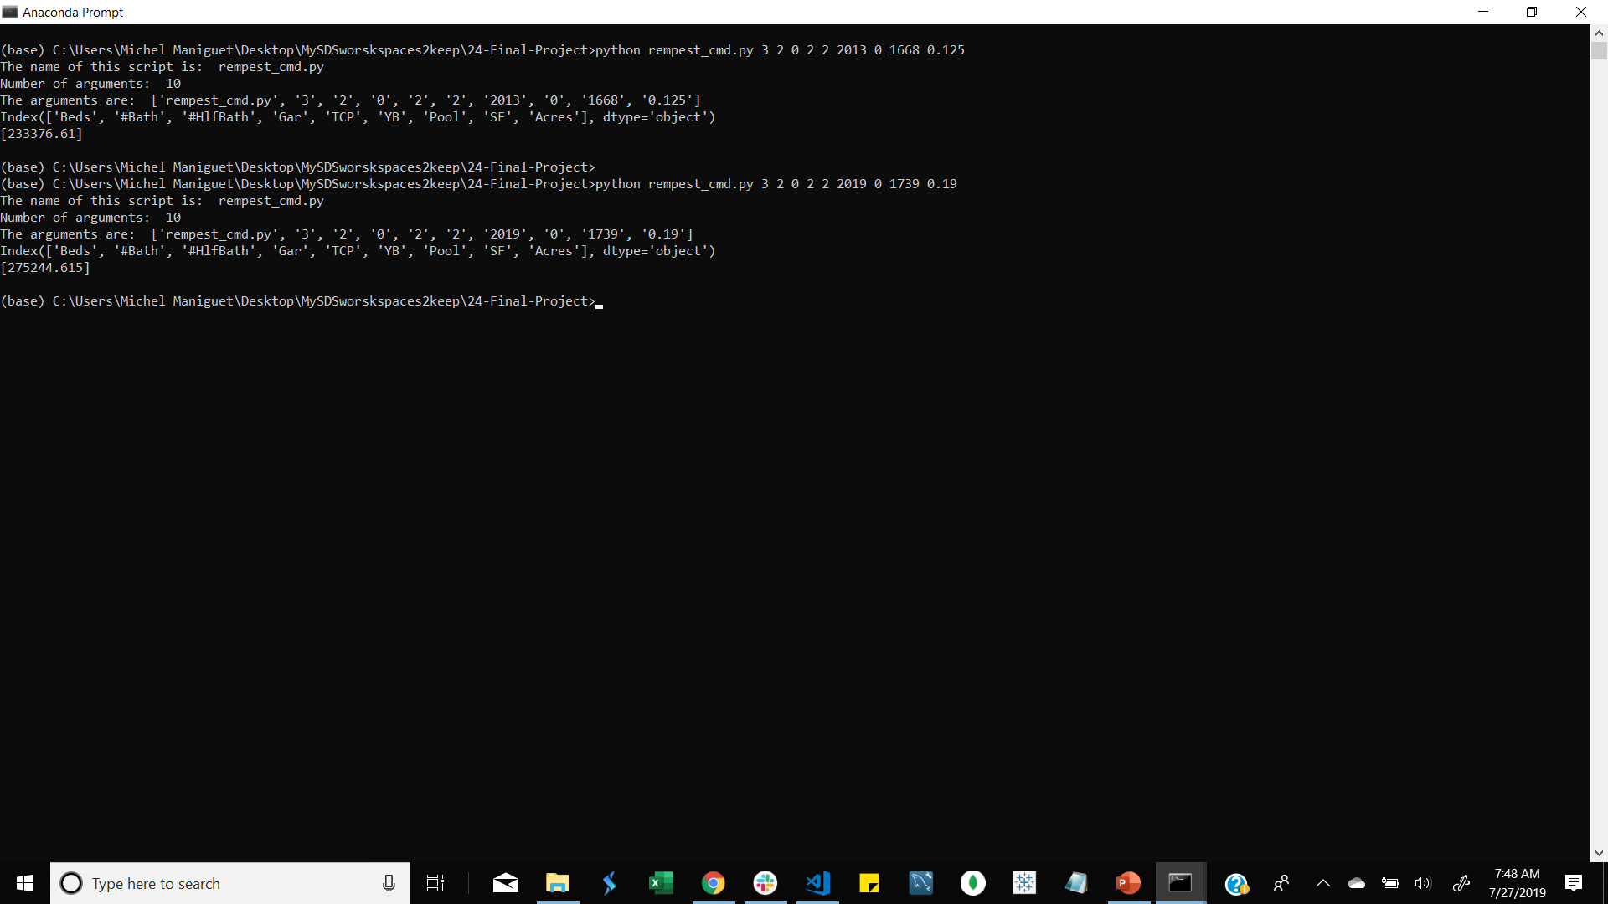

Slide 36
12. Solve my problem
Result 1: predicted = [233376.61]
actual = 214000
% difference = +9.05%
Result 2: predicted = [275244.615] actual = 259900
% difference = +5.9%

Slide 37
Conclusions
Back to the beginning…
Question: Can Machine Learning Predict the Sale Price of a House?
Answer: Yes, but…

Slide 38
Conclusions
We have new problem:
How can I make the model more accurate?

Slide 39
Can Machine Learning Predict the Sale Price of a House?

Slide 40
The quick answer: Better model More data

